Slide 1

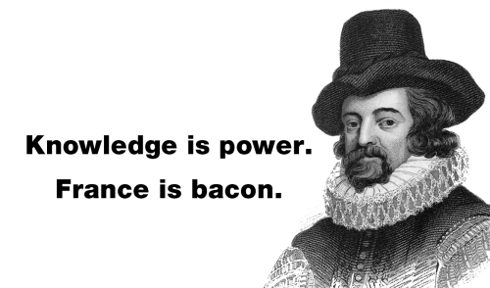

Slide 2
Francis Bacon
-- the father of empiricism and the Scientific Revolution of the Renaissance period

Slide 3
1.
Life & Political career

Slide 4
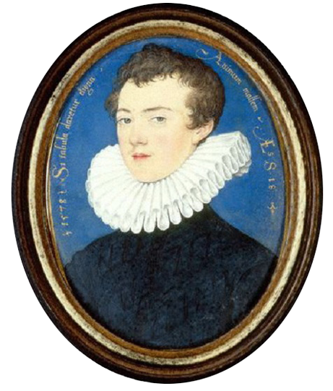
Timeline
the sudden death of his father meant Bacon returned home to London, where he began his practice of law at Gray’s Inn
Entered Cambridge where he followed a traditional medieval curriculum
1561
1573
1576
1579
Born 22 January 1561 near the Strand, London, England
travelled to the continent, studied civil law and became acquainted with political realities

Slide 5
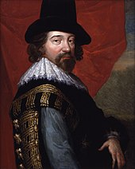
Four Stages
Elected to Parliament (1581)
The succession of James I (1603)
Lord Chancellor (1618)
public disgrace (1621)
Sir Francis Bacon, c. 1618

Slide 6
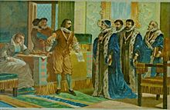
Lord Chancellor and public disgrace
Bacon's public career ended in disgrace in 1621. He was arrested for corruption, as a victim to an intrigue in Parliament.

Slide 7
Bacon saw no way out for himself and declared himself guilty.
“My lords, it is my act, my hand, and my heart; I beseech your lordships to be merciful to a broken reed.”

Slide 8
2.
Influence In Science

Slide 9
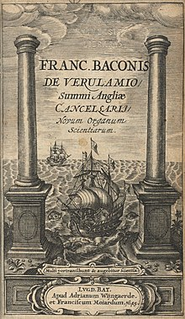
Scientific inquiry
Most influential
the duty of a scientist was to take a skeptical approach to any preconceptions, but only rely on the actual evidence and results of experiments.
Novum Organum (New organon《新工具》)
“Knowledge is power.”

Slide 10
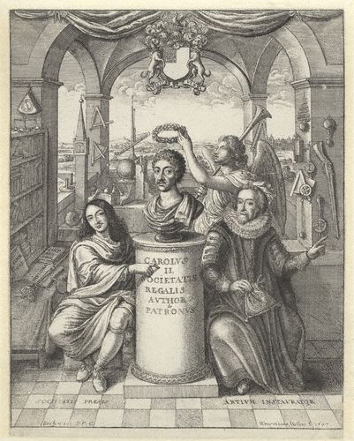
Frontispiece to 'The History of Royal-Society of London'
picturing Bacon (to the right) among the founding influences of the Society

Slide 11
the father of empiricism
the possibility of scientific knowledge based only upon inductive reasoning and careful observation of events in nature.
science could be achieved by the use of a skeptical and methodical approach whereby scientists aim to avoid misleading themselves.

Slide 12
3.
Legacy In Law

Slide 13
the Napoleonic Code is
“the sole embodiment of Bacon‘s thought”
Bacon's legal work
"has had more success abroad than it has found at home“
--The historian William Hepworth Dixon

Slide 14
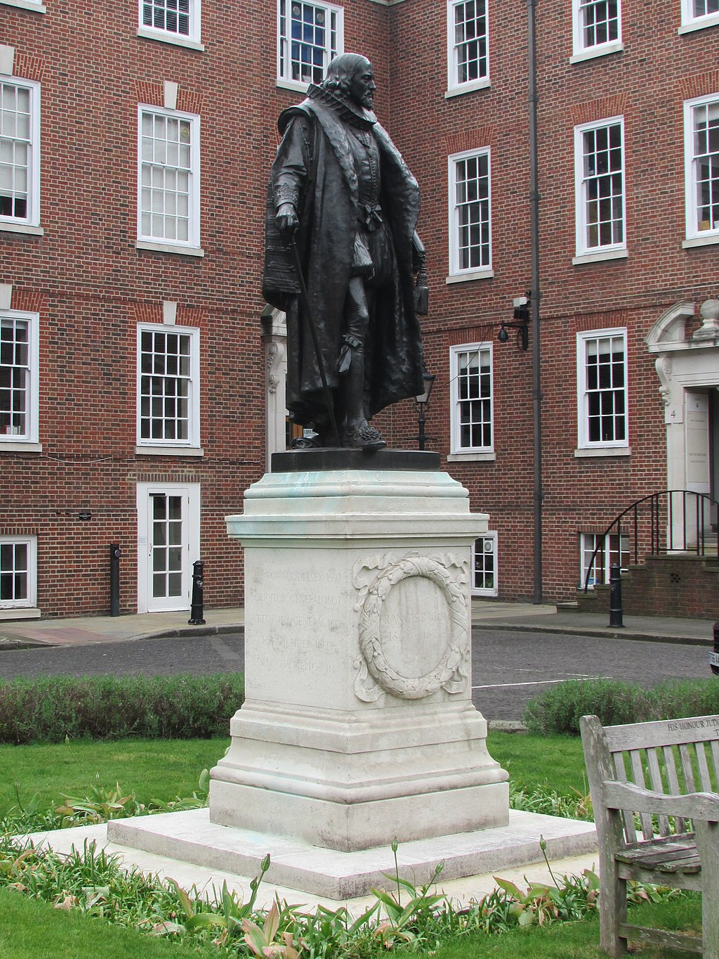
Law
Greatest contribution
place emphasis on the facts of the case, rather than a strict statement of legal precedent.
to be more about the evidence and facts of the case, and not get caught up in obtuse legal precedents.

Slide 15
Conclusion
revolutionary figure in constitutional law, science and philosophy

Slide 16
Thanks!

